Slide 1

HOST: Master Coordinator JOANNE NISTICO
GUESTS: Senior Coordinator PAM BUDNER and Director DR. JENNIFER CANCIO
TOPIC: WHAT IT TAKES TO GROW YOUR SHAKLEE BUSINESS RIGHT NOW!
Agenda:
Setting the Stage for Your Goals: Joanne Nistico - Let's review your OPA Trip
Dollar Tracker to help you earn money for the 2025 Shaklee Leadership Summit.
2. Getting into Action: Dr. Jennifer Cancio - How to up-level your business activity using a simple tracking sheet.
3. The Power of One More: Pamela Budner - Learn about the importance of small, consistent actions for growth.

Slide 2

How to Grow Your Shaklee Business Right Now!
THE POWER OF YOUR WHY
Have you lost touch with your Why?
Are you going through the motions?
What’s Your Vision and Focus for your business and your future
What is your intention & strategy for getting there?
What is Your Weekly Activity PLAN?
What is Your Expectation?
ARE YOU CONSISTENT?

Slide 3
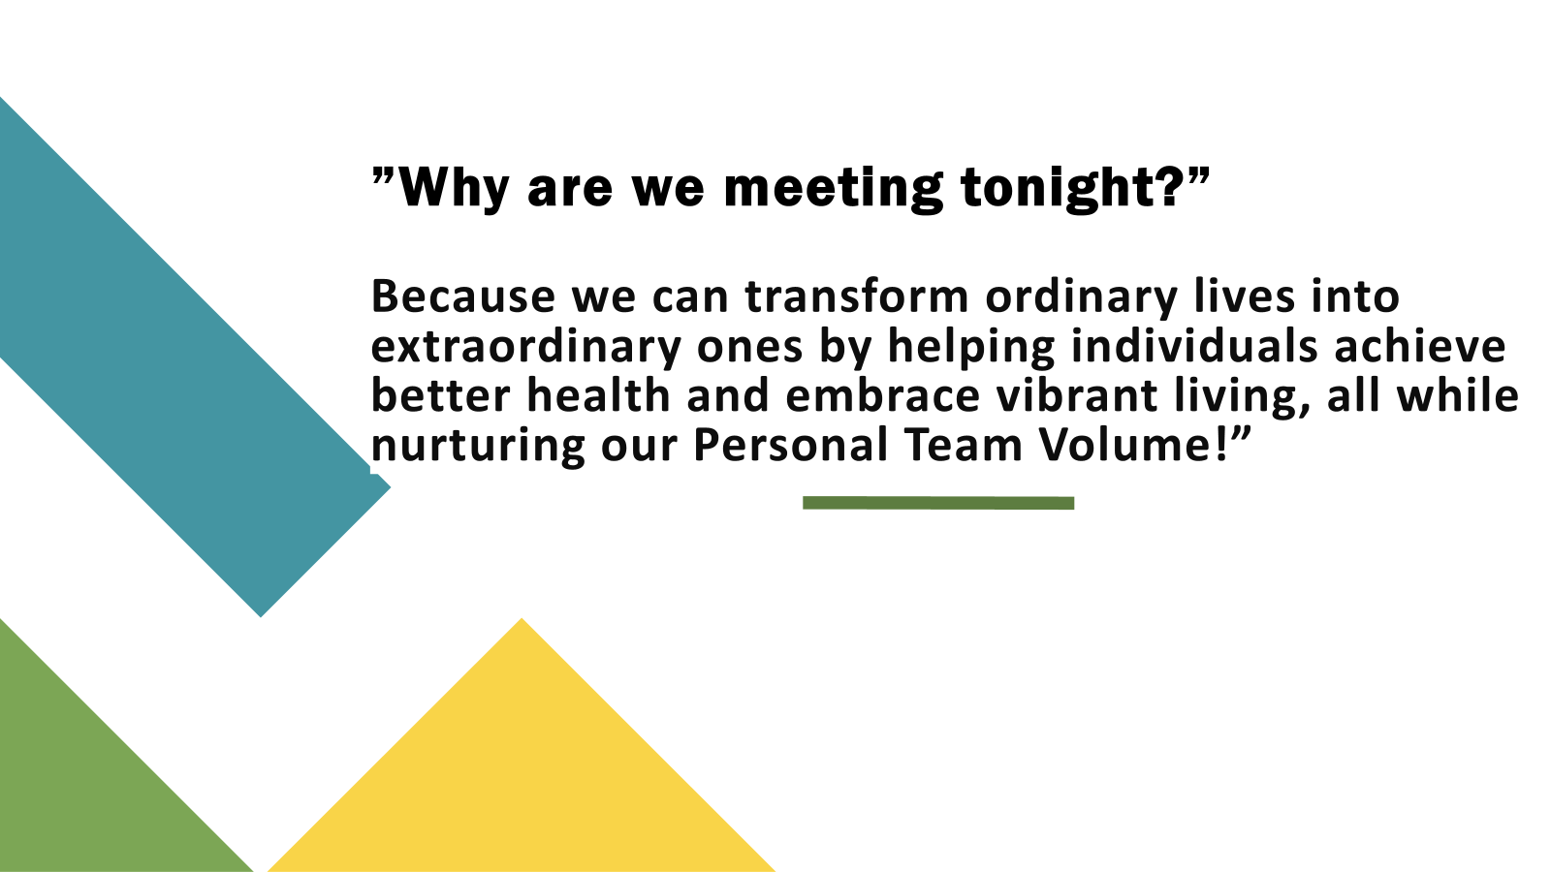

Slide 4
OPA TRIP DOLLAR Tracker
Weekly Activity Success Tracker
These tools are:
Used to evaluate where you are, what is happening in your business, and what you need to change or improve your skills.
Are educational tools to help you improve your sales and leadership skills?
A mentor can assist you with focus, strategy, and direction.
A Master Mind Team of two or more can help you keep momentum.
•Don’t give up, Adjust
Keep the Long View in Mind!

Slide 5
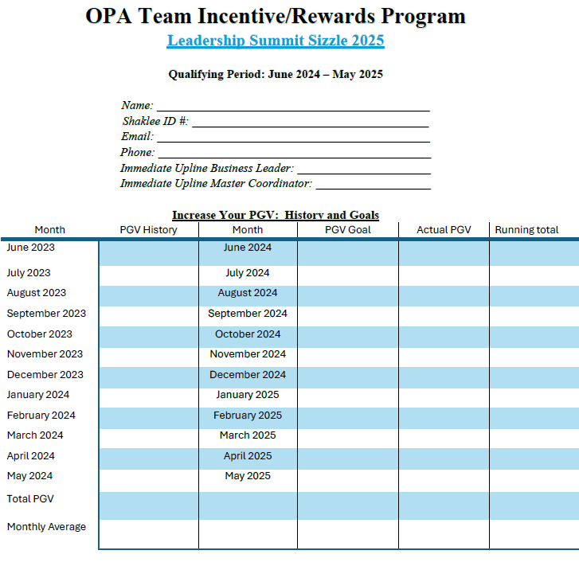
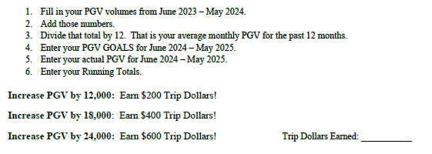
Increase your Monthly PGV
Increase your Monthly PGV

Slide 6
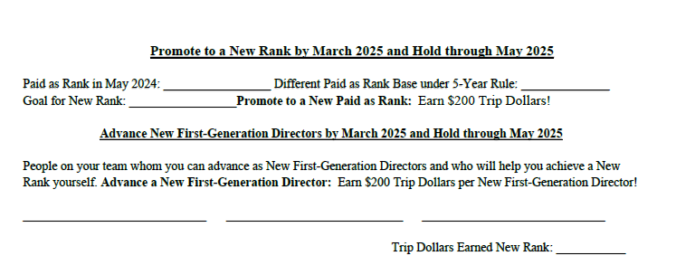
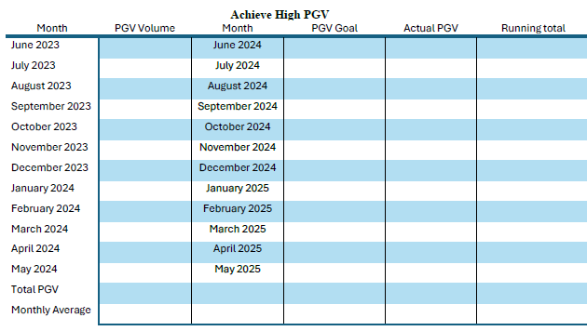
Achieve High PGV
NEW RANK

Slide 7
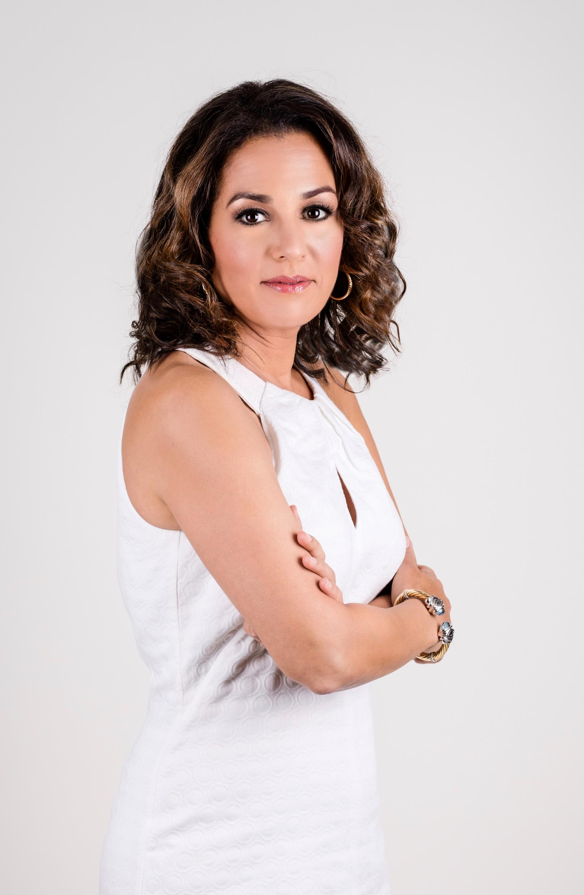
Weekly Activity Tracker for Success, Fun, and Making a Difference
Dr. Jennifer Cancio

Slide 8
Weekly Activity Tracker for Success, Fun, and Making a Difference – Date: __________
What are your three Fishing holes?
What are your Reaching Out Methods (ROMs)?
Make three contacts per week, reaching out to New People.
Who were your three weekly connections with people (phone/face-to-face/zoom)?
Who did you speak to when you brought up the business opportunity?
What are you currently doing for Personal Development?
Book:
Audio:
Journaling:
Choose three Shaklee TV to watch and share each week:
What did you do this past week that made you feel like you were stretching yourself into a new activity?
RESULTS for the week:

Slide 9

Small, Practical things
“The Power of One More”
Up-Tempo Your Action
For Example: Being Ready to make one more call.
Contact one more person.
Plant one more seed.
Pamela Budner

Slide 10
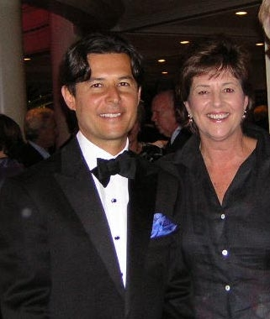
“Be Boldly Confident in the Value of What We Offer.
We Are Stable and Growing!
Plant the Seeds and Be Proud!”
Roger Barnett

